Slide 1
Inland Navigation in the Baltic Sea Region Competitiveness Improvement Plan (CIP)
2019-02-15

Slide 2
Content
EMMA I korthet
Competitive Improvement Plans
Östersjön och Internationellt
Slutsatser och rekommendationer

Slide 3
Interreg Östersjöprogrammet – EMMA-projektet
…SYFTAR TILL ATT FÖRBÄTTRA MÖJLIGHETER FÖR INLANDSSJÖFART I ÖSTERSJÖOMRÅDET
Enhancing freight Mobility and logistics in the BSR by strengthening inland waterway and river sea transport and proMoting new internAtional shipping services
Koordinerande partner: Port of Hamburg Marketing
Projektpartners: 20 (från DE, FI, LT, PL, SE)
Associerade partners: 45+
Finansiering från: Interreg Östersjöprogrammet
Project Budget: 4.42 million € Varav ERDF sam-finansierat 3,45 million €
Projekttid : 3/2016 – 2/2019
Notes:
How to achive aims?
Pilot actions
to analyse and akquire data
To proof concepts and to demonstrate potentioals
Stakeholder plattform which acts neutral in regar of competition
Exhibitions
Events
Public information
Lobby work and lobby strategies
Together with existing organisations and associations

Slide 4
The EMMA project
PILOT AKTIVITETER OCH DEMONSTRATIONER
Sverige – Göteborgsområdet (Vändern)
Överflyttning av gods från väg till vattenvägarna i Göta Älv och Vänerområdet
Finland – Norra Karelenia (Saimaa Kanal & Sjö)
Förbättra förutsättningar för IVV i Saimaa kanal och sjö
Tyskland (Norra Tysklands flodsystem)
Digital karta med statusinformaiotn om inre vattenvägar (RIS)
Polen – Gdańsk (Vistula-floden)
Förstudie för multimodal inlandsterminal
Litauen – Klaipėda (Neman-floden)
Transporter av tungt gods och specialtransporter till inlandet
| Koncept för retrofit av dieseldrivlinor.
Notes:
Lake Malären (SE) and Saimaa canal (FI) are heavily affected by ice in winter times
Same Standards and Harmonisation in Europe needed

Slide 5
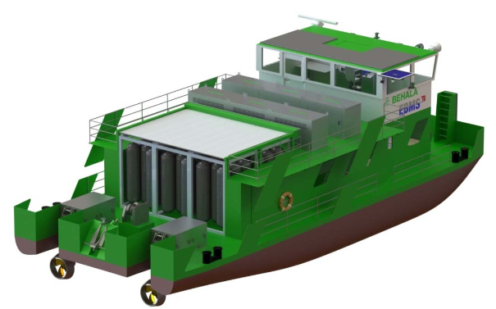
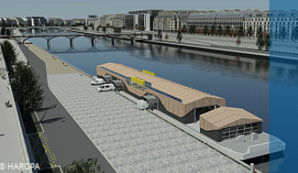
The EMMA Vision for the Baltic Sea Region
IWT is a green, smart transport mode, well integrated in multi-modal supply chains with remarkable share in the modal split
IWT is well considered in strategic transport network planning and legislation
A clear ITS strategy (RIS/VTS) is in place and enables smart shipping solutions
An alternative fuel network is in operation serving a modern, smart and green IWT fleet
Transition points between different waterway classes and there interlinks are established
Sectors’ voice is strengthened
© BEHALA/ TUB-EBMS
© Watertruck+
Notes:
IWT stakeholders from BSR countries are well represented in national associations and organisations which themselves support European and international associations and institutions (CESNI, UNECE)
Knowledge sharing and exchange between the stakeholders is practiced on BSR/EU level (IWT-platform)

Slide 6
Content
EMMA in a Nutshell
Utvecklingsstrategier (Competitive Improvement Plans)
Baltic Sea Region and International
Conclusions and Recommendations

Slide 7
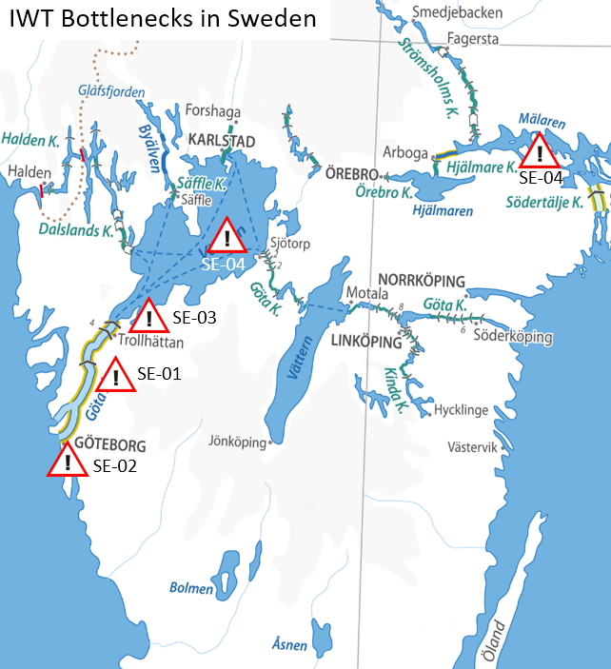
Sverige
Infrastrukturella flaskhalsar och potentialer
I Sverige är Inre vattenvägar (IVV) en relativt ny företeelse och ett transportslag under utveckling. Med dennanya utveckling kommer alla behov och tumaningar med ny lagstiftning och regelverk och att skapa affärsmässiga förutsättningar för en inlandssjöfart under utveckling
Då IVV har introducerat sent I Sverige jänfört med manga Eurpoeiska länder, är det administrative ansvaret sprit mellan manga myndighethert och organsiationer.
Regelverk för vattenvägar är baserat på IMO/SOLAS. En harmoniserande ansats gentemot IVV, I förhållande till EU-standrader är nödvändig. → T.e.x Hittills ett väldigt avgränsat område som kalssats som IVV, lotskrag, farledsavgifter,.
Sex slussar(120 år gamla) mellan Göteborg och Vänern måste förnyas. Medel för detta har nyligen blivit identifierade I den nationella infrastrukturplanen
Notes:
All SE bottlenecks are not part of any TEN-T Core Corridor.
SE-01 Göta River from Göteborg (Göta River Bridge) to Vänersborg → Insufficient River Information System applications
Since there are conflicts between river traffic and passing train and roadways, earlier RIS-pilot (GOTRIS) showed a need for traffic synchronization between different modes of traffic. New bridge over Göta River in the center of Göteborg have legal prerequisites to be followed by some sort of traffic management system addressing issues above.
The GOTRIS concept was developed and piloted in 2014 showing how the identified issued could be resolved. Decision for implementing a similar system is pending the decision of reinvestments of locks. Initiative for a pre-implementation through CEF instrument is being discussed.
Positive effects: Better usage of the river infrastructure, less waiting time for vessels at bridges (openings), lower CO2 emissions, better energy efficiency, less waiting time for public transport
Task force instigated (SMA, STA, City of Göteborg) to address the issue. Initiative through CEF instrument to do a pre-implementation (SMA,STA)
SE-02 New Göta Älv bridge → Clearance height restrictions (e.g. low bridge higts)
New bridge in central of Göteborg over the river will have clearance height of 12 m, compared to existing bridge of 18m
Restrictions Mon-Fri, 06-09, 15-18) for vessels with height clearance over 12 m. (Compared to todays 18 m)
SE-03 Trollhättan-locks
The locks are approaching end of economic and technical lifetime. Should WIT still be possible in future six locks need to be replaced before 2030.
Costs: Preliminary estimated to be about Euro300 million. Ongoing study by Trafikverket in cooperation with SMA.
Effects: Larger capacity, shorter time to pass, lower number of locks, higher reliability
SE-04 Inaccessible areas for IWW traffic – legal obstacles
The limited coverage of the area classified as IWW is a bottleneck. In Sweden only the two lakes of Mälaren and Vänern, including Göta river from the high bridge at the entree of Göteborg to Lake Vänern.
More areas outside of the mentioned needs to be classified, even if as Category 1, but to be able to connect industries and ports that are to be found in the region outside of the mentioned lakes.
Effects: Extended area of operation for a future IWW fleet, leading to an extended reach and access to more cargo as well as opportunities.

Slide 8
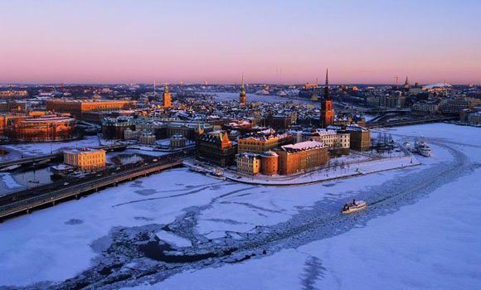
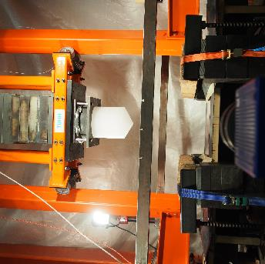
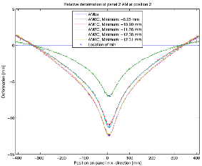
Sverige: Modellering av Is -påverkan på IVV-fartyg
I samverkan med forskningsorganisationerna KTH (SE) ock TUHH (DE)
Ett av de vanligaste identifierade hindren för IVV-trafik är osäkra förhållanden för vinternavigering.
Projektet har velat besvara frågan; Vad är Vinterförhållanden för IVV? Vilka isförhållanden skall ett IVV-fartyg designas för att klara? Projektet bidrar till kunskap om is-påverkan, lämplig skrovkonstruktion vad avser form och material, materialkoncept och strukturkonstruktioner.
En modell för beräkning av krafter och energier vid is-påverkan har utvecklats
Testmetodik är utveckat I projektet
Första testserier är utförda I projekt

Slide 9
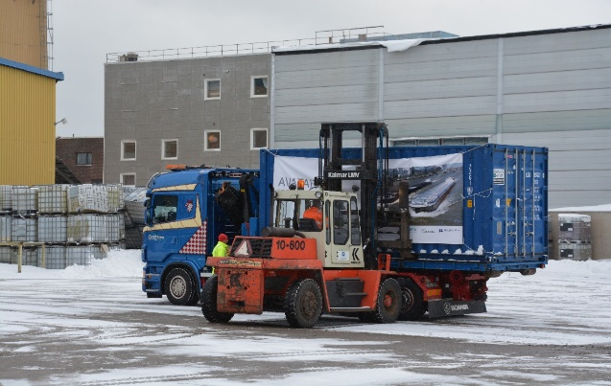
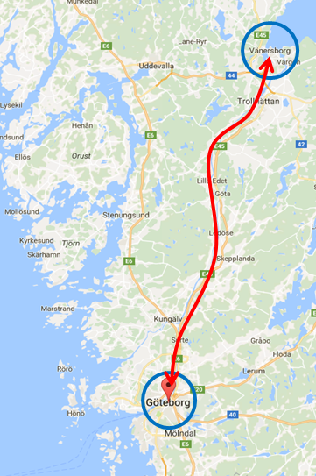
Pilot Sverige: Vänern och Göta Älv
Första utvecklingen av IVV i Sverige
Containerpendel – Vänersborg
Regelbunden pendeltrafik förväntas
Modern push-pråm är troligvis möjligt koncept
Längdbegränsing på 89 m (slussars storlek)
Pilot-resa genomfördes 7:e Mars 2017
Befintliga farleder kan användas och god kapacitet finns tillgänglig.
Slussbegränsingar är viktiga aspekter, särskilt med tanke på slussinfrastrukturens ålder.
Notes:
Sweden implemented the EU Directive 2006/87/EC (a set of rules and regulations dictating technical and operational requirements for ships engaged in inland waterway traffic) in December 2014 but no commercial traffic has started.
The test sailing was on Avatar Logistics initiative and why they did it is because Sweden needs to “kick off” the inland navigation.
According to the plan the pilot project managed to test the full logistics chain in reality, loading in Göteborg, transport by barge, discharging in Vänersborg, reloading to truck and delivery to the customer.
The container pilot in Göta älv was executed with vessel and barge equipment that are available in Sweden. Meaning that this not is an efficient equipment, technical & financial for a permanent liner service.
The idea with the pilot is to attract the market the possibilities with inland navigation, since this is new in Sweden and to push the politicians to finalize the regulations for inland vessels/traffic.
Simultaneously AVATAR Logistics will develop a vessel type for Scandinavian weather conditions’.

Slide 10
Sweden
Rekommendationer och slutsatser
Samla alla relevant intressenter involverade inom transportområdet för att skapa en gemensam målbild för framtiden för Svenska inre vattenvägar (Nationell samordnare för inlandssjöfart och inre vattenvägar har tillträtt 2019).
Att bygga upp en lobbystruktur som fokuserar på IVV ochsom representerar Sverige I europeiska och internationella sammahang är nödvändigt
Svensk IVV-lagstiftning bör vara harmoniserad med Europeisk lagstiftning i så stor utsträckning som möjligt.
UNECE diskuterar möjligheten att utöka resolution 61 med regler för “River/Sea” fartyg, där IVV fartyg tillåts att trafikera utanför IVV-zoner.
Detta kan, från ett Östersjöperspektiv, knyta ihop områden klassificerade som Zon 3-1 (som I Sverige) och möjliggöra att större volymer gods transporteras på vatten mellan hubbar.
© AVATAR Logistics Ab

Slide 11
Content
EMMA in a Nutshell
Competitive Improvement Plans
Baltic Sea Region and International
Conclusions and Recommendations

Slide 12
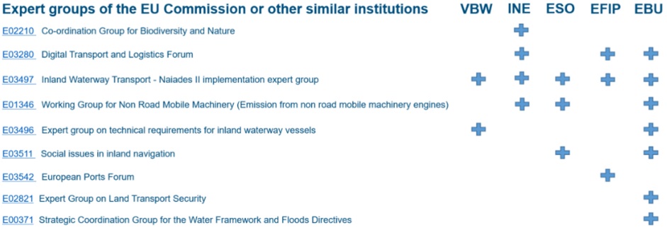
Make Use of Existing Responsibility Structures
Expert Groups by the European Commission
Registered European branch organisations can be heard in EU COMs Expert Groups.
Representatives from BSR countries in these European branch organisation are crucial to be heard and to strengthen entire sectors’ voice, thus:
National branch organisations should be strengthened in all BSR countries by regional stakeholders.
National branch organisations themselves should be part of European- respectively international branch organisations.
Member states should be part of institutionalised policy working groups etc. as well.
Notes:
On European level several IWW associations represent the sector towards EU institutions like the EU Parliament, the EU Commission and the EU Council. On European level several lobby organisations exist focusing on inland navigation, namely European Barge Union (EBU), European Federation of Inland Ports (EFIP), European River-Sea-Transport Union (ERSTU), European Skippers’ Organisation (ESO), Inland Navigation Europe (INE) and the Association for inland navigation and navigable waterways in Europe (VBW).
Analyses in the project showed the lack of members from the Baltic Sea Region (besides Germany and Poland to some extend) represented by IWW associations in Brussels. This is due to the fact of missing national branch associations. However, especially the acquisition of single private organisations from one country should not come along with the privilege representing this country officially on European levels. The danger is to represent single interests of one/some financially strong members and not the entire sector of the country. Thus, it can be stated, that the national drawback is also influencing sectors representation on the European level.
However, it has to be clearly stated, that cooperation between the associations exist and increases. Besides others joint statements, policy-/recommendation papers and events are organised to bundle forces. Strengths of the individual associations are getting used by all, even though not in any kind of business yet.

Slide 13
Make Use of Existing Responsibility Structures
CESNI Committee and UNECE
A special role plays the “Central Commission for Navigation on the Rhine” (CCNR). CCNR and the EU COM created a European committee for drawing up common standards in the field of inland navigation: CESNI, www.cesni.eu
The CESNI Committee directly influences European legislation (e.g. RIS) and as such all member states should be present (which is not the case in respect of all BSR countries).
The UNECE Working Party on Inland Water Transport is called “SC.3”. Representatives from Member states, their waterway administration or River Commissions are appointed to represent national interests in the different working parties and committees.

Slide 14
European information systems for inland waterway transport
Different Systems in the Baltic Sea Region
In Central Europe implementation of interoperable RIS will provide information for navigation and operations.
In some BSR countries, e.g. the Nordics, inland waterways are connected to sea rather than other inland waterways.
Short Sea-, River-Sea- and Lake-Sea ships are using the same infrastructure.
A separate RIS system is not existing and is probably not being installed.
Similar Vessel Traffic Services (VTS) systems, Automatic Ship Identification (AIS) and single window data sharing systems are in operation.
Therefore, regulations and operational practices should take interoperability of both systems (RIS/VTS) into account.
© City of Lappeenranta

Slide 15
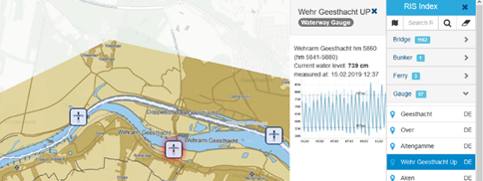
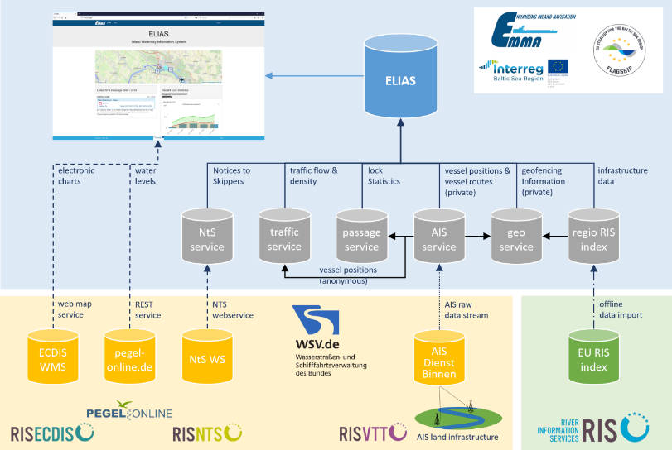
Making Use of Existing River Information Services
A prototype to support vessel masters, fleet and cargo managers was created to demonstrate modern information technology potentials - ”ELIAS”:
Open source and public accessible map based web application: https://elias.isl.org/index.xhtml
Information on waterway infrastructure is gathered from the European RIS index
The anonymised vessel positions (based on real-time AIS) allow a calculation of traffic density and traffic flows
Passage statistics service
Notices to Skippers Service
Geofencing service

Slide 16
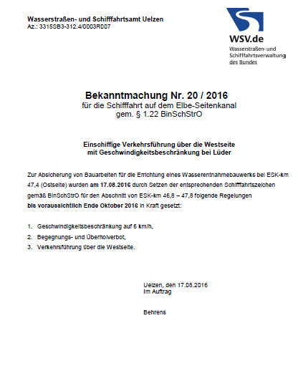
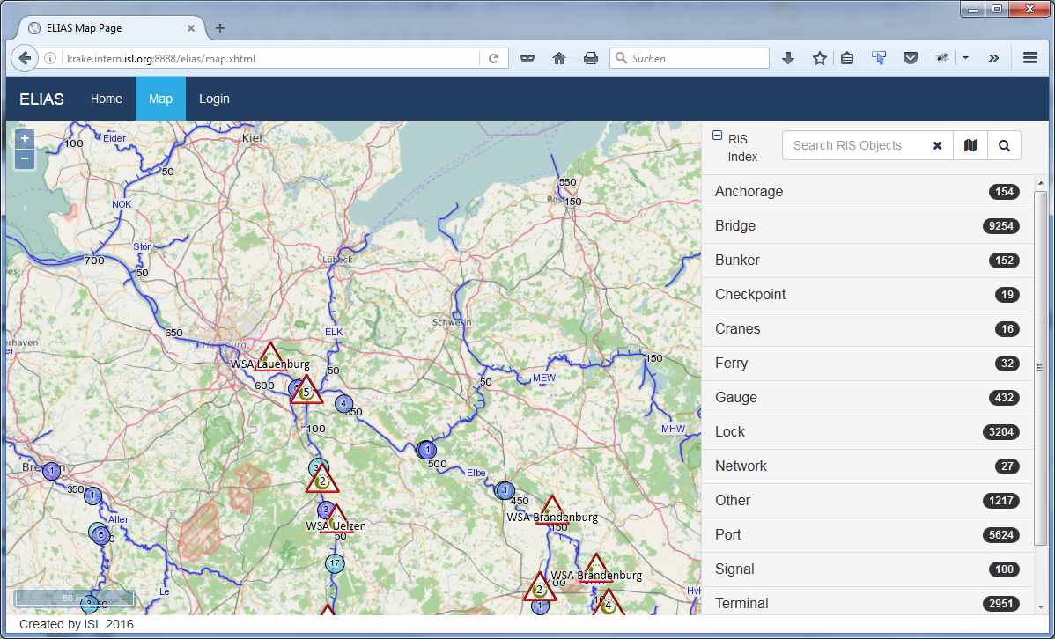
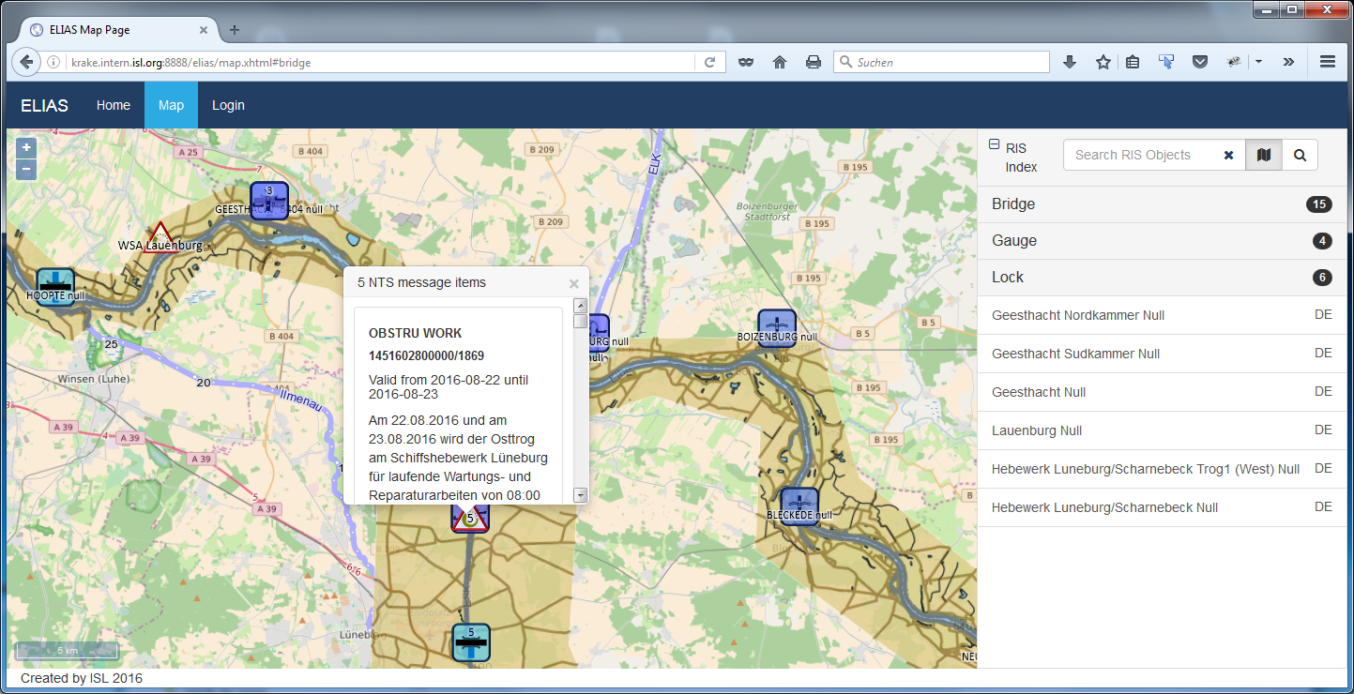
Making Use of Existing River Information Services
“ELIAS” FUNCTIONALITIES (Developed in EMMA)
Browsable map pan & zoom
Info on RIS objects
Geocoded NtS message display
Link to external details
Notes:
Technique and public section:
Electronic Chart Display and Information System (ECDIS)
Electronic navigational chart overlay (iENC): Position of locks, bridges, gauges, bunker stations, etc.: European RIS Index Publicly available contents is rather heterogeneous.
Notices to Skippers (NtS), German service integrated. Other countries to follow. Fallback via proprietary subscriptions (email) possible
Display of water levels (WRM messages based on NtS)
Possible value added information: trends, hotspots, vertical clearance under bridges
General traffic information based on anonymised AIS data
traffic density
lock waiting times
AIS land infrastructure is available in parts of Germany. Discussions with ministry are ongoing.
Inclusion of detailed ports & terminal data
Map-based web application providing static and basic status information on IWW
Electronic navigational chart overlay (iENC)
Position of locks, bridges, gauges, bunker stations, etc.: update of European RIS Index
Notices to Skippers (NtS): Only NtS-WebService from Germany currently integrated.
Real time water levels - provided by German waterway authorities (WSV)
Dynamic traffic situation: traffic density (no of vessels per section) & traffic flow (vessel speed per section)
Lock passage statistics (lock passage time = waiting time + lockage time)

Slide 17
Content
EMMA in a Nutshell
Competitive Improvement Plans
Baltic Sea Region and International
Conclusions and Recommendations

Slide 18
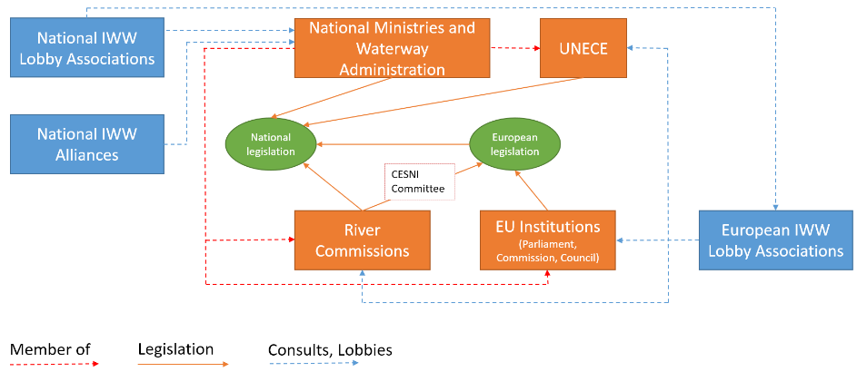
Enhance Administrative and Branch Associations’ Structures

Slide 19
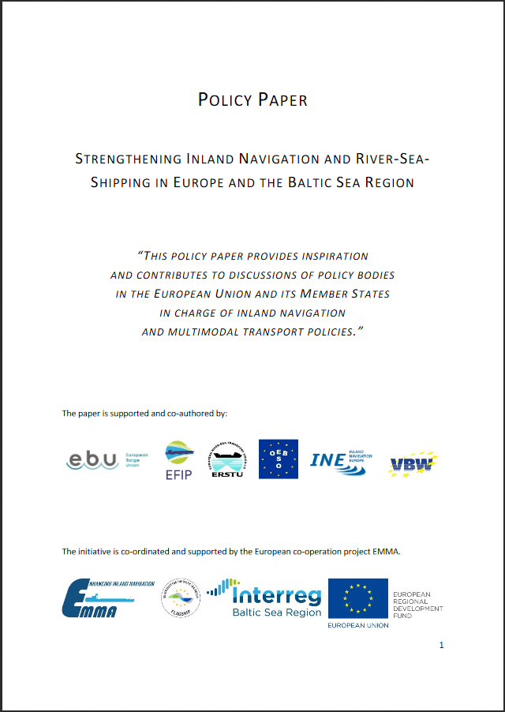
A Clear BSR Strategy to Lift IWT Potentials is Needed
EMMA Position Paper to Enhance IWT
IWT integrated in multimodal logistic solutions
Respect the different characteristics of waterways
Transition points between different waterway classes and there interlink
Inclusion of a clear strategy for the uptake of alternative fuel technology
Inclusion of a clear ITS strategy (RIS & VTS Services)
Harmonised national rules and regulations
Investments to strengthen and modernise infrastructure is needed (shore site and on-board)
European Inland Waterway Transport Knowledge Platform
Smart & Innovative Strategic IWW Transport Projects
www.project-emma.eu/sites/default/files/EMMA_Policy%20Paper%20to%20strengthen%20IWT%20in%20BSR.pdf
Notes:
Identified challenges:
Investment and innovation backlog, ashore & on board
Inhomogeneous national regulations and markets
Weather conditions can be challenging (e.g. ice)
Lack of attention for inland navigation and available infrastructure
Stronger cooperation of stakeholder needed (→lobby structures)
Smart projects needed to lift potentials, to bring innovation to the sector and to keep started procedd alive!
Inland waterways should play a more important role in the Baltic Sea Region in future!
VTS = Vessel Traffic Service
RIS = River Information Service

Slide 20
Thank you for your attention.
2019-02-15

